Slide 1
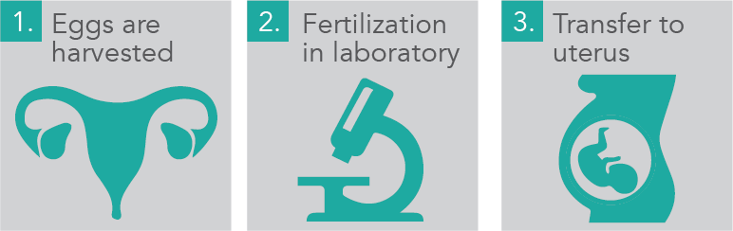
PGD
Pre-implementation Genetic Diagnostic

Slide 2
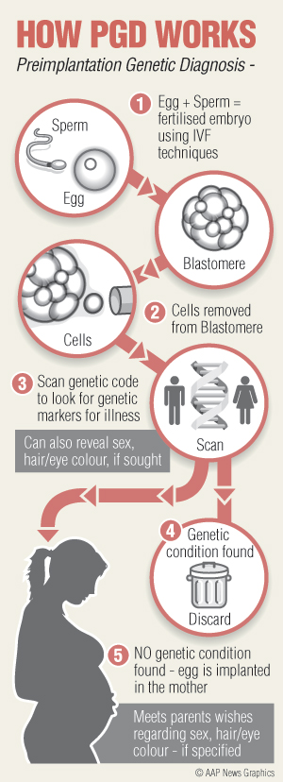
How does PGD work ?
Fertilization in Lab
Maturation
3) Selection

Slide 3
Advantages | Disadvantages
Reduce the chance of carring a baby with a life-threatening diseases : Decreases risk to couples or individuals with serious inherited disorders of having children affected with same problem help detect known genetic diseases or chromosomal abnormalities Reduces multiple pregnancy risk by identifying healthy embryos for implantation | Risks of ovarian hyperstimulation syndrome, multiple pregnancy Tests do not screen for all possible genetic diseases or disorders, so a healthy baby is not guaranteed from a tested embryo Not used only to avoid a disease : ethical problem

Slide 4
To conclude, nowadays, the scientists are able to screen embryos, mostly for parents who want to reduce the chances of carrying a baby with life-threatening diseases. This is « Pre-implementation Genetic Diagnostic », PGD. Then, the doctor explains that they can go one step further by implanting embryos that give traits parents want. So we are able to choose how our baby would look like.
https://www.youtube.com/watch?v=XlKCaDfEQnY

